Slide 1
Aditya Prakash
Aspiring Intern at Toyota InfoTechnology Center

Slide 2
EDUCATION
Bachelors
Masters
B.Tech
Computer Science
IIIT- Vadodara
CPI 7.94
MS
Computer Science
University of Texas at Dallas
GPA 3.763*
*Currently Enrolled

Slide 3
PROFILE
Linkedin
https://www.linkedin.com/in/aditya-prakash-74039b14b/
Github
https://github.com/adityaiiitv
Updated resume mailed

Slide 4
Tools
and Technologies
Unity, Blender
API: Google VR, OpenCV, Playmaker
Hardware: HTC Vive, Samsung Gear VR
Platform: Android, WebGL, Vive Simulator
Languages: C#, C++,

Slide 5
Work Samples

Slide 6
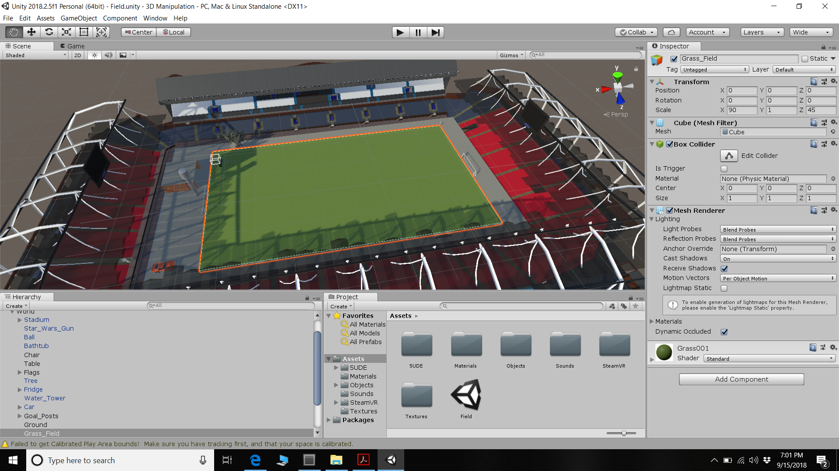
Soccer Stadium

Slide 7
Soccer Stadium
Realistic, scaled
Sounds
Object Manipulation States: Open, Hold, Closed, Enlarge
Movement States
Vive Simulator
Team of 2

Slide 8
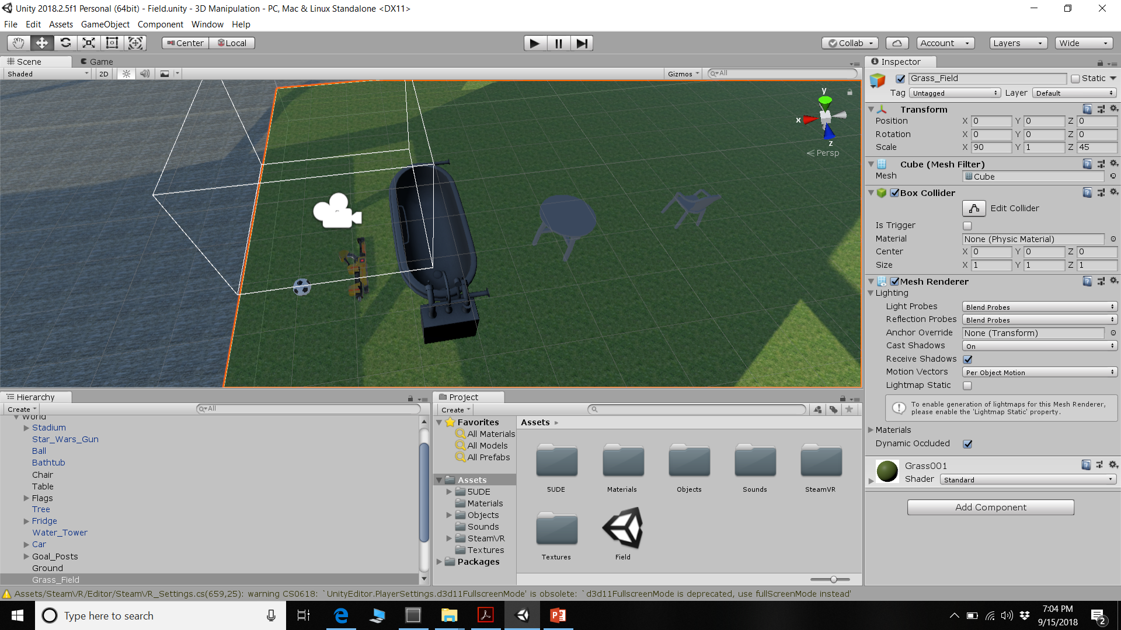

Slide 9
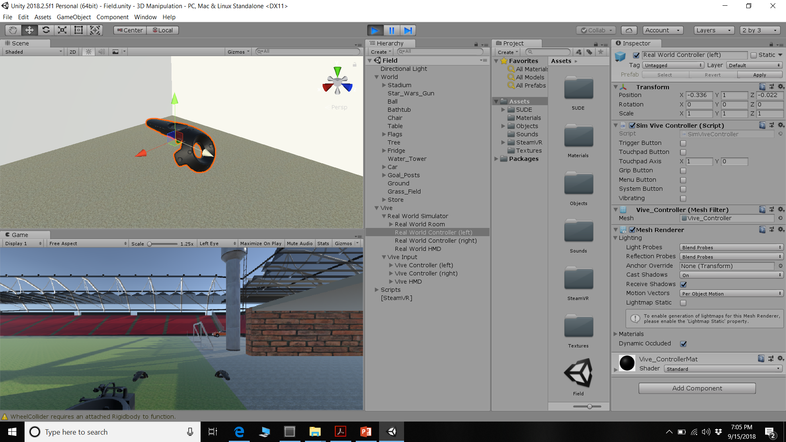

Slide 10
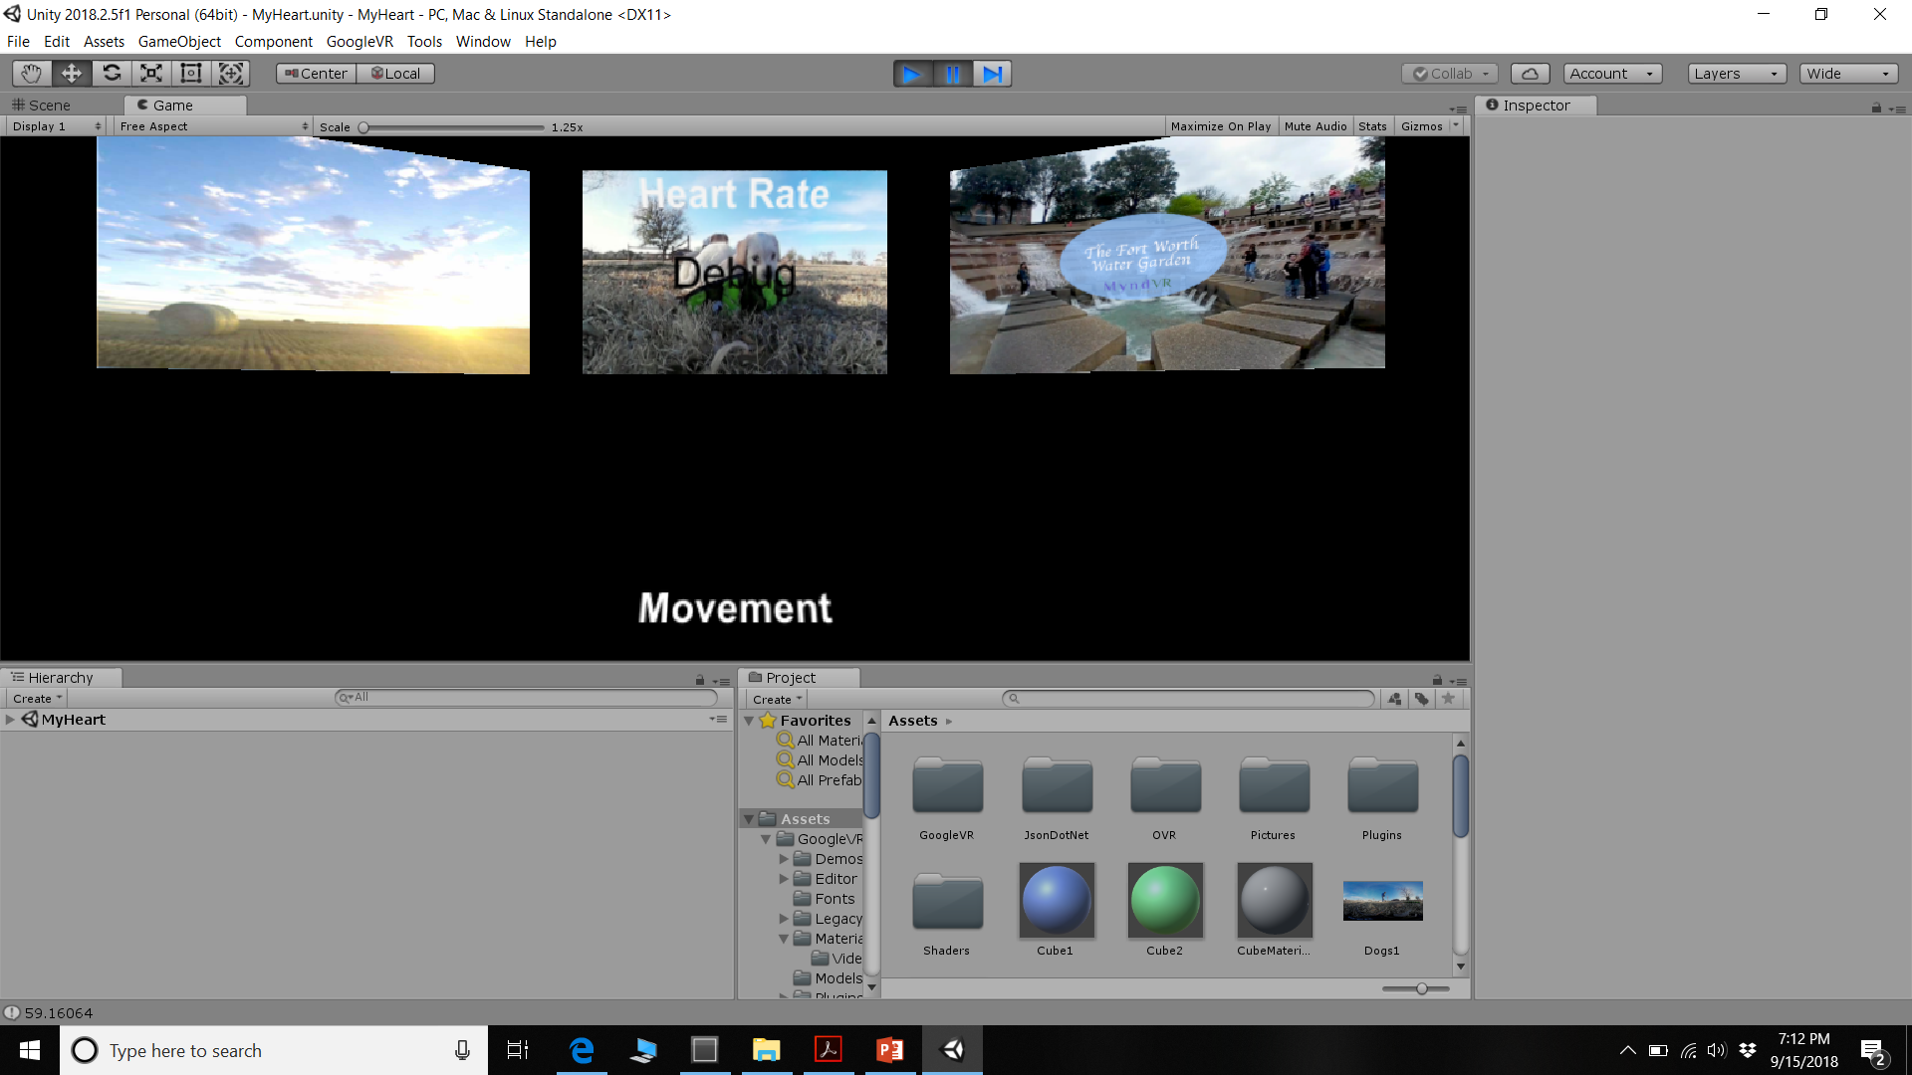
My Heart for MyndVR

Slide 11
My Heart for MyndVR
Samsung’s GearVR, Gear Fit 2 Pro, Galaxy S6
Google VR API
Live logging and display
Team of 5

Slide 12
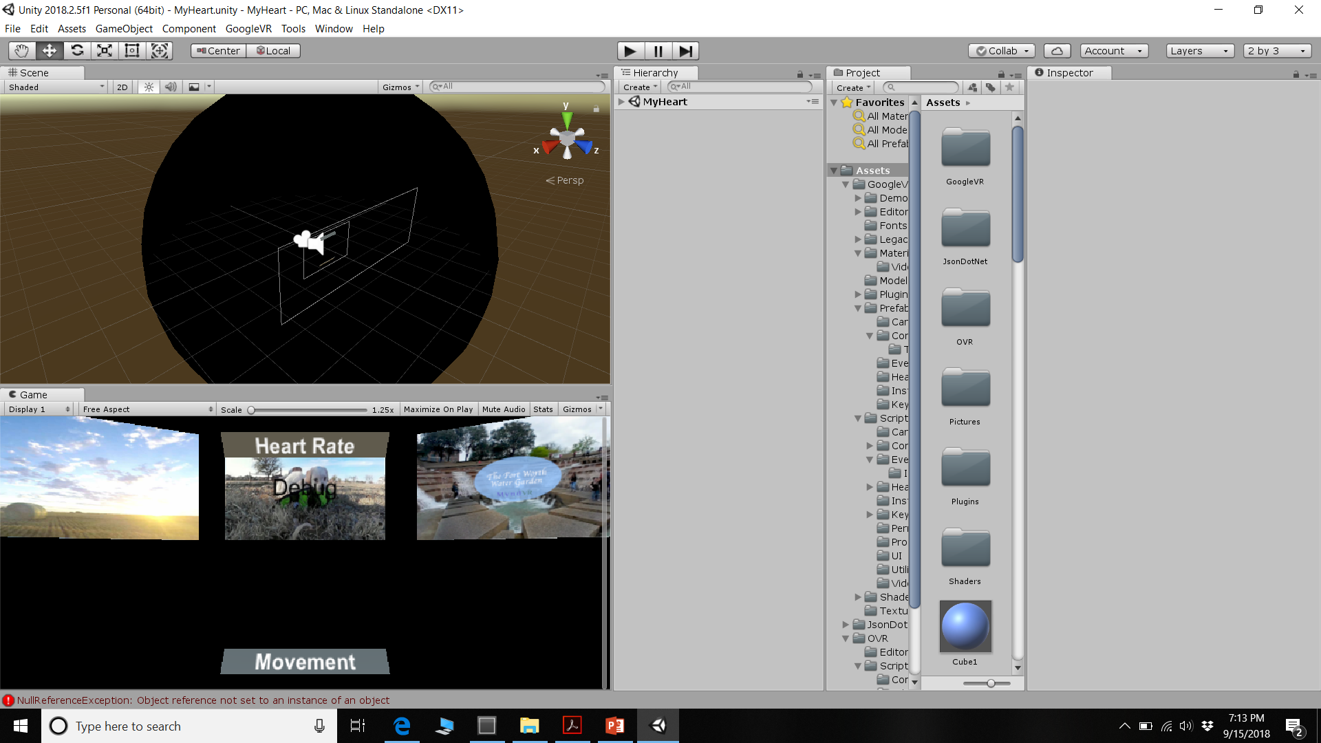

Slide 13
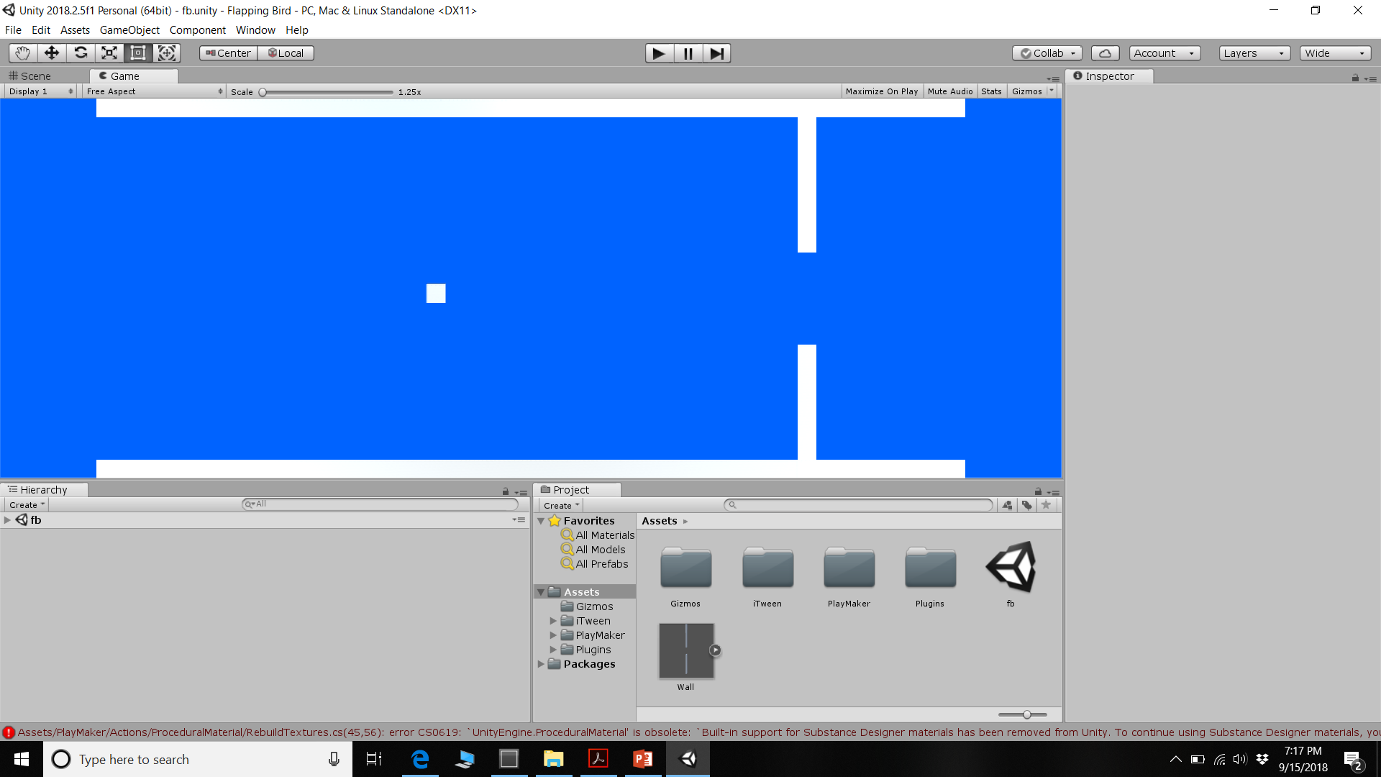
Flappy Bird

Slide 14
Flappy Bird
Playmaker
Smooth
Finite State Machines

Slide 15
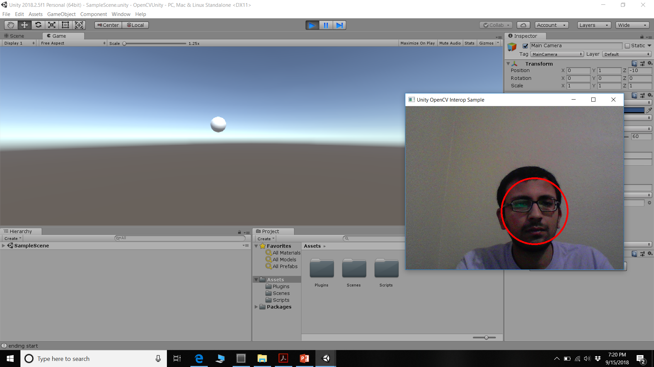
Unity with OpenCV

Slide 16
Unity with OpenCV
Previous experience with OpenCV
Atos
Geeksforgeeks
C++, Python, OpenCV

Slide 17
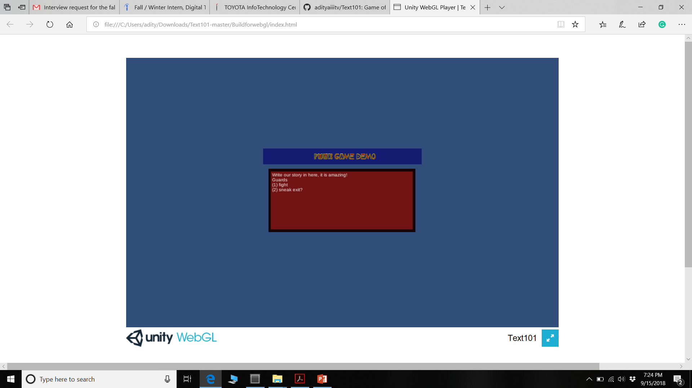
Text Based Fantasy Game Skeleton

Slide 18
Text Based Fantasy Game Skeleton
Future games, personal interest
Online Course
WebGL

Slide 19
Current Work
Researcher and Unity Developer under Dr. Midori Kitagawa at UT Dallas on Project: STEPP
FSM based learning application for high-school students
Funded by NSF

Slide 20
What Interests me?
Digital Twin Technology
Building Simulation Environment
Innovation
Research

Slide 21
Why am I a good fit?
Unity experience
Programming
Passionate
Coursework with Unity, C#, AI, ML

Slide 22
Contact
Phone: 682-558-7629
Email: aditya.prakash101194@gmail.com

Slide 23
Thank You!

